Slide 1
Unit 02 Cloud Computing Architecture

Slide 2
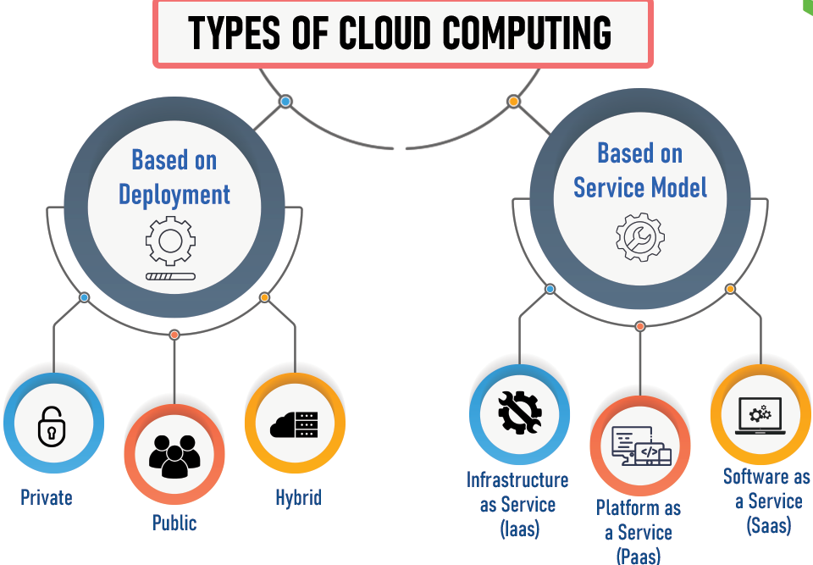
Cloud computing
Cloud computing refers to the delivery of computing services over the internet ("the cloud") to offer faster innovation, flexible resources, and economies of scale.
It encompasses a variety of services such as servers, storage, databases, networking, software, and more.

Slide 3
Cloud computing
Comparison with Traditional Computing Architecture (Client/Server):
Traditional Computing (Client/Server) | Cloud Computing
In a traditional client/server model, computing resources are centralized on dedicated servers within an organization's premises. | Cloud computing operates on a decentralized model where resources are virtualized and delivered via the internet.
It requires upfront investment in hardware and software, often leading to higher initial costs. | It offers a pay-as-you-go pricing model, allowing organizations to pay only for what they use (operational expenditure vs. capital expenditure).
Scaling typically involves upgrading hardware, which can be costly and time-consuming. | Scaling is horizontal, enabling organizations to add or reduce resources quickly and efficiently as per demand.

Slide 4
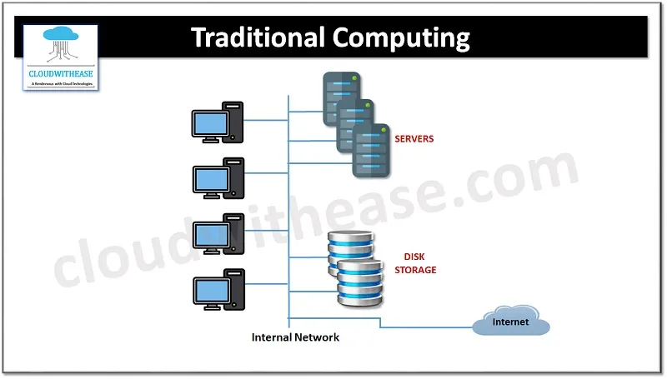
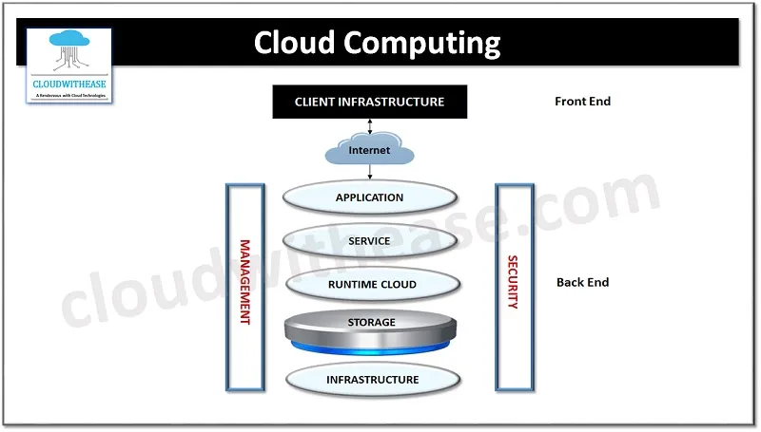
Cloud computing
Comparison with Traditional Computing Architecture (Client/Server):

Slide 5
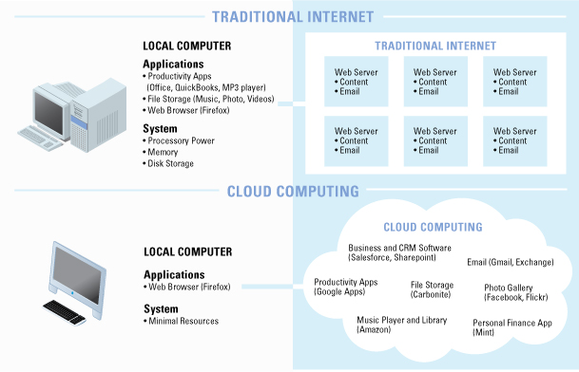
Cloud computing
Comparison with Traditional Computing Architecture (Client/Server):

Slide 6
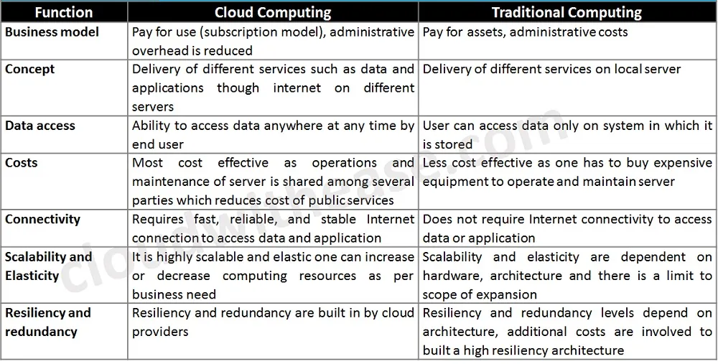
Cloud computing
Comparison with Traditional Computing Architecture (Client/Server):

Slide 7
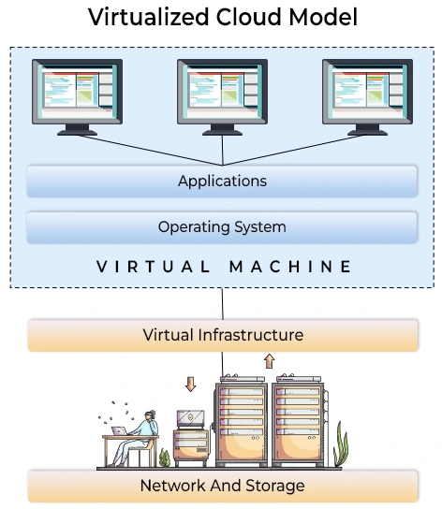
Cloud computing
How Cloud Computing Works:
Key Components:
Virtualization: Enables the sharing of physical resources among multiple virtual environments, optimizing resource utilization.

Slide 8
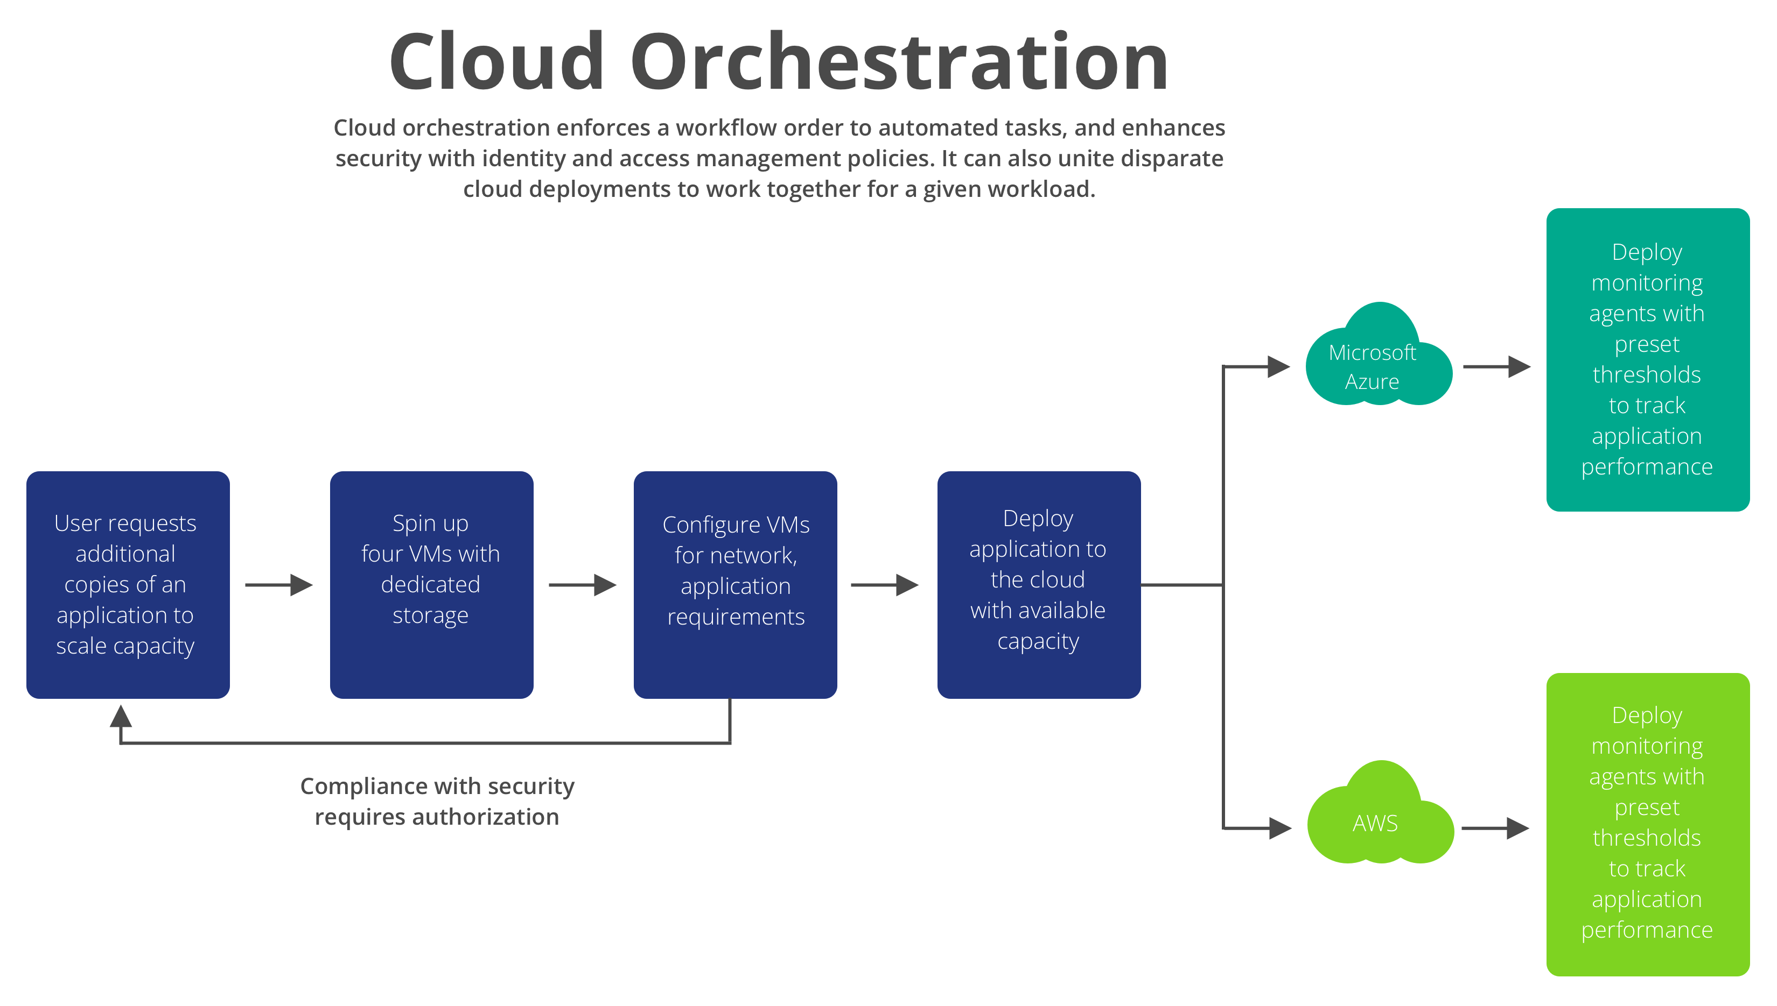
Cloud computing
How Cloud Computing Works:
Key Components:
Orchestration: Automates the provisioning, management, and scaling of cloud resources, ensuring efficient operations.

Slide 9
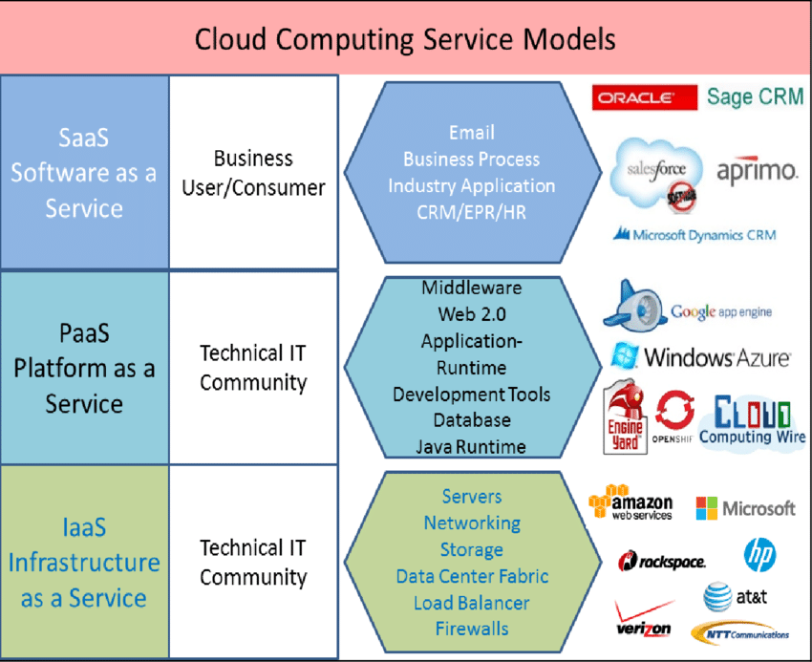
Cloud computing
How Cloud Computing Works:
Key Components:
Service Models: IaaS, PaaS, SaaS represent different levels of abstraction and management responsibilities.

Slide 10
Cloud computing
How Cloud Computing Works:
Role of Networks:
Connectivity: Ensures reliable access to cloud services.
Bandwidth Management: Handles data transfer efficiently.
Security: Protects data in transit and at rest.

Slide 11
Cloud computing
How Cloud Computing Works:
Protocols Used:
HTTP/HTTPS: For web-based services.
TCP/IP: Fundamental for data transmission.
RESTful APIs: Facilitate communication between services.

Slide 12
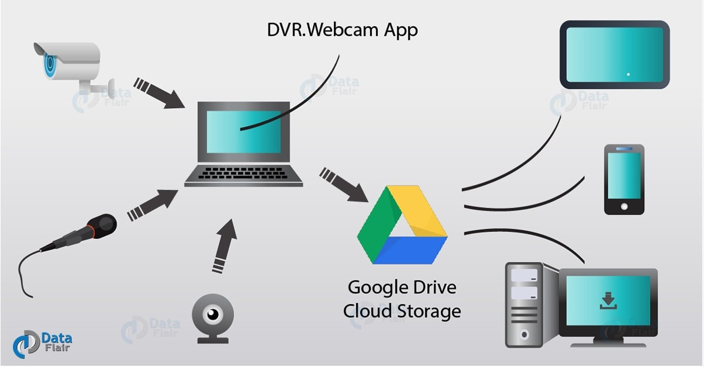
Cloud computing
How Cloud Computing Works:

Slide 13
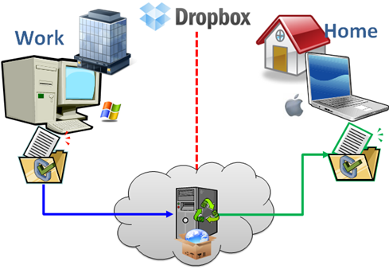
Cloud computing
How Cloud Computing Works:

Slide 14
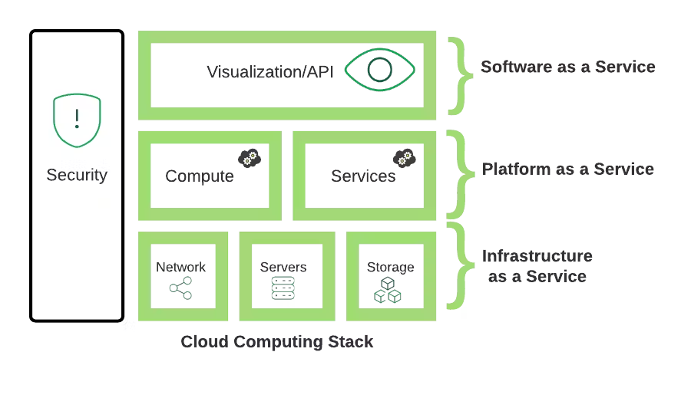
Cloud computing stack
Cloud computing services are divided into three classes, according to the abstraction level of the capability provided and the service model of providers, namely:
(1) Infrastructure as a Service
(2) Platform as a Service
(3) Software as a Service
These abstraction levels can also be viewed as a layered architecture where services of a higher layer can be composed from services of the underlying layer.
The role of each layer in an integrated architecture.

Slide 15
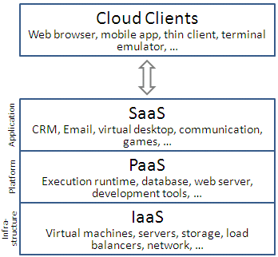
Cloud computing stack
A core middleware manages physical resources and the VMs deployed on top of them; in addition, it provides the required features (e.g., accounting and billing) to offer multi-tenant pay-as-you-go services.
Cloud development environments are built on top of infrastructure services to offer application development and deployment capabilities; in this level, various programming models, libraries, APIs, and mashup editors enable the creation of a range of business, Web, and scientific applications.
Once deployed in the cloud, these applications can be consumed by end users.

Slide 16
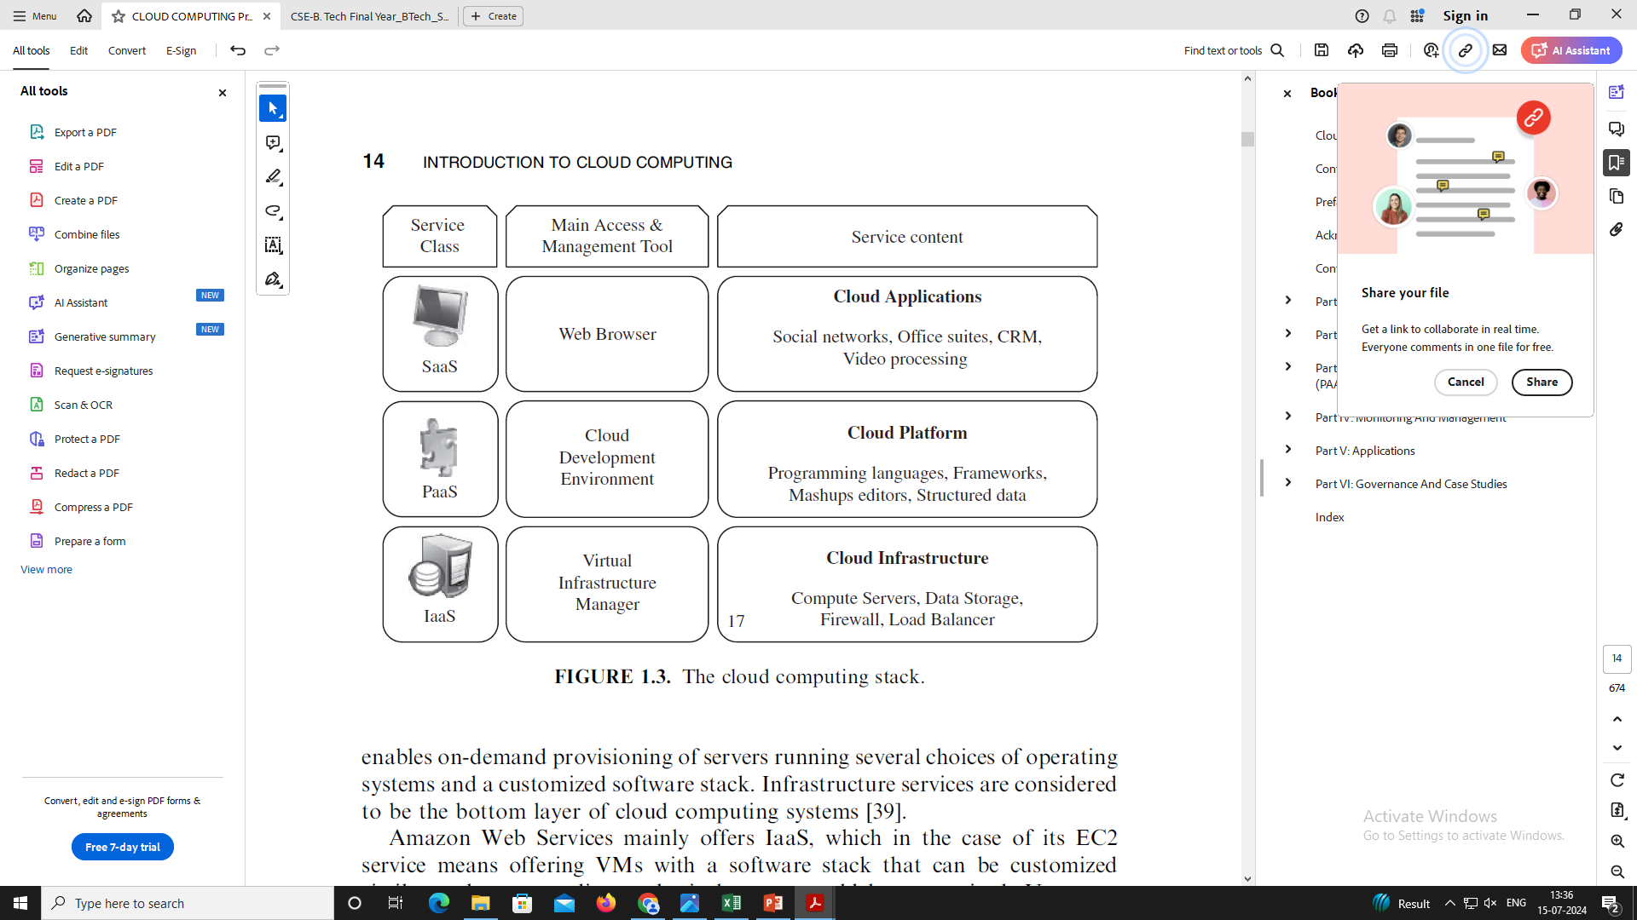
Cloud computing stack

Slide 17
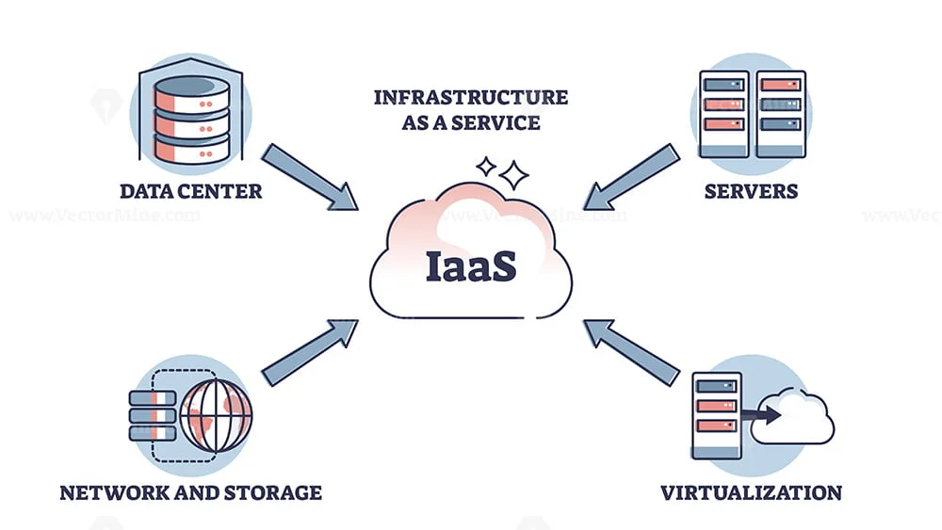
Cloud computing stack
Infrastructure as a Service:
Offering virtualized resources (computation, storage, and communication) on demand is known as Infrastructure as a Service (IaaS).
A cloud infrastructure enables on-demand provisioning of servers running several choices of operating systems and a customized software stack.
Infrastructure services are considered to be the bottom layer of cloud computing systems.

Slide 18
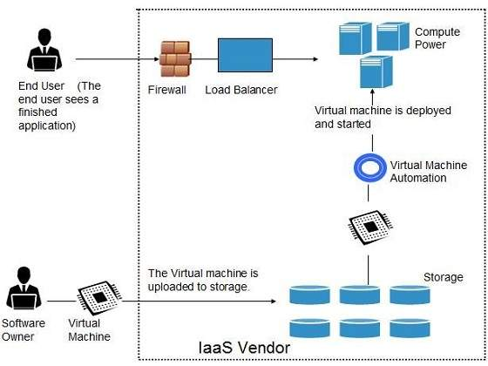
Cloud computing stack
Infrastructure as a Service:
Amazon Web Services mainly offers IaaS, which in the case of its EC2 service means offering VMs with a software stack that can be customized similar to how an ordinary physical server would be customized.
Users are given privileges to perform numerous activities to the server, such as: starting and stopping it, customizing it by installing software packages, attaching virtual disks to it, and configuring access permissions and firewalls rules.

Slide 19
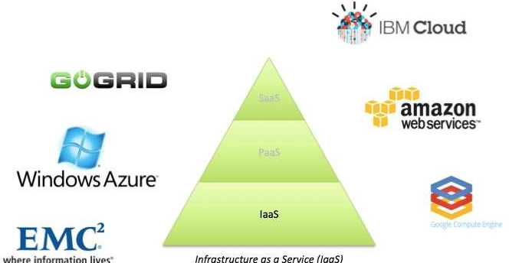
Cloud computing stack
Infrastructure as a Service:
IaaS provides virtualized computing resources over the internet.
It includes virtual machines, storage, and networking.
Users have control over operating systems, applications, and some networking components.
Example providers include Amazon Web Services (AWS) EC2 and Microsoft Azure Virtual Machines.

Slide 20
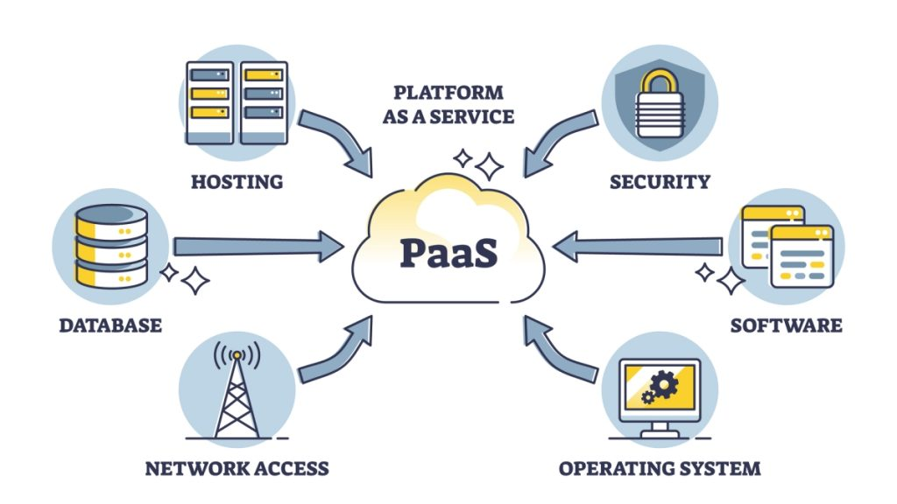
Cloud computing stack
Platform as a Service:
In addition to infrastructure-oriented clouds that provide raw computing and storage services, another approach is to offer a higher level of abstraction to make a cloud easily programmable, known as Platform as a Service (PaaS).
A cloud platform offers an environment on which developers create and deploy applications and do not necessarily need to know how many processors or how much memory that applications will be using.

Slide 21
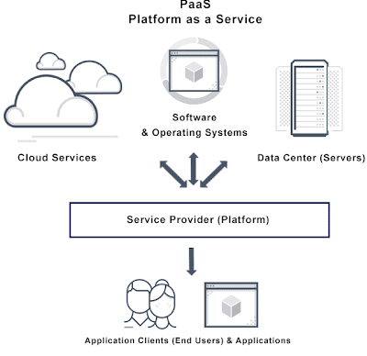
Cloud computing stack
Platform as a Service:
In addition, multiple programming models and specialized services (e.g., data access, authentication, and payments) are offered as building blocks to new applications.
Google AppEngine, an example of Platform as a Service, offers a scalable environment for developing and hosting Web applications, which should be written in specific programming languages such as Python or Java, and use the services’ own proprietary structured object data store.
Building blocks include an in-memory object cache (memcache), mail service, instant messaging service (XMPP), an image manipulation service, and integration with Google Accounts authentication service.

Slide 22
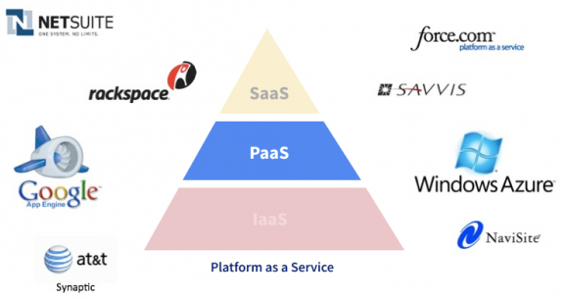
Cloud computing stack
Platform as a Service:
PaaS offers a platform allowing customers to develop, run, and manage applications without dealing with the complexity of building and maintaining the underlying infrastructure.
It includes middleware, development tools, database management systems, and more.
Example platforms include Google App Engine, Heroku, and Microsoft Azure App Service.

Slide 23
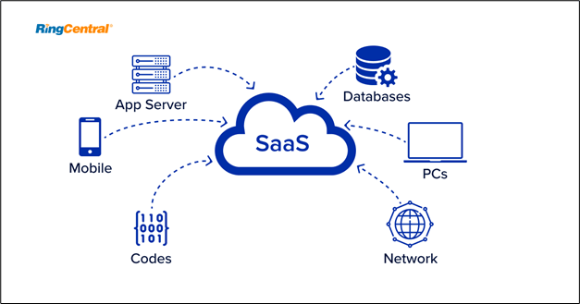
Cloud computing stack
Software as a Service:
Applications reside on the top of the cloud stack. Services provided by this layer can be accessed by end users through Web portals.
Therefore, consumers are increasingly shifting from locally installed computer programs to on-line software services that offer the same functionally.

Slide 24
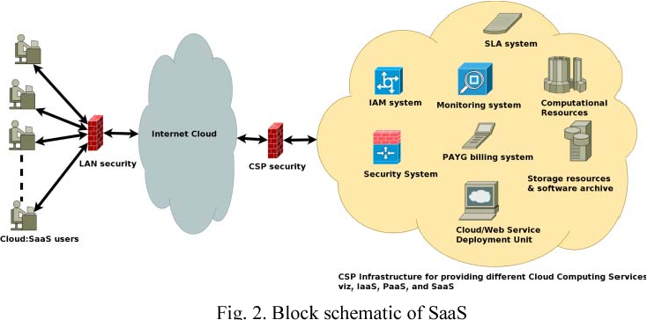
Cloud computing stack
Software as a Service:
Traditional desktop applications such as word processing and spreadsheet can now be accessed as a service in the Web.
This model of delivering applications, known as Software as a Service (SaaS), alleviates the burden of software maintenance for customers and simplifies development and testing for providers.
Salesforce.com, which relies on the SaaS model, offers business productivity applications (CRM) that reside completely on their servers, allowing costumers to customize and access applications on demand.

Slide 25
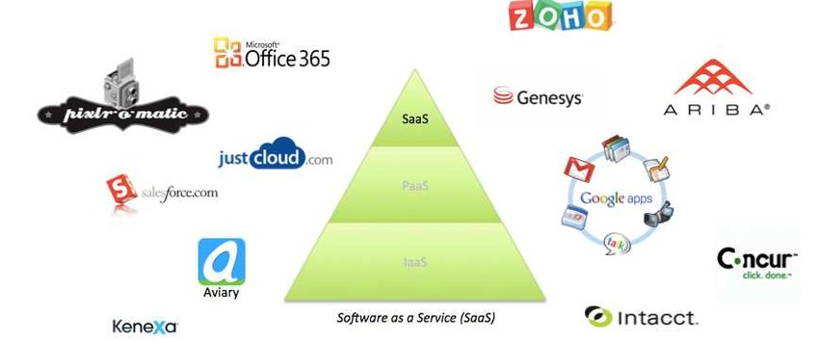
Cloud computing stack
Software as a Service:
SaaS delivers software applications over the internet on a subscription basis.
Users access these applications via web browsers without needing to install or maintain software locally.
Examples include Salesforce (CRM), Google Workspace (formerly G Suite), and Microsoft Office 365.

Slide 26
Cloud Deployment Models
Deployment Models:
Although cloud computing has emerged mainly from the appearance of public computing utilities, other deployment models, with variations in physical location and distribution, have been adopted.
In this sense, regardless of its service class, a cloud can be classified as public, private, community, or hybrid based on model of deployment.

Slide 27
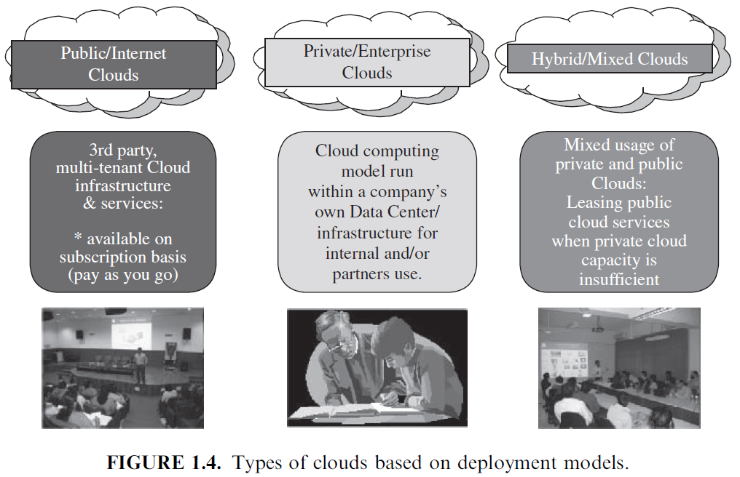
Cloud Deployment Models

Slide 28
Cloud Deployment Models
In most cases, establishing a private cloud means restructuring an existing infrastructure by adding virtualization and cloud-like interfaces.
This allows users to interact with the local data center while experiencing the same advantages of public clouds, most notably self-service interface, privileged access to virtual servers, and per-usage metering and billing.

Slide 29
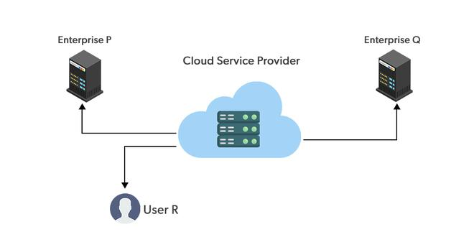
Cloud Deployment Models
Public Cloud:
Definitions for public cloud as a “cloud made available in a pay-as-you-go manner to the general public”.

Slide 30
Cloud Deployment Models
Public Cloud:
Public clouds offer services over the internet to multiple customers, leveraging economies of scale to provide cost-effective and scalable solutions.
Example providers include AWS, Azure, and Google Cloud Platform (GCP).

Slide 31
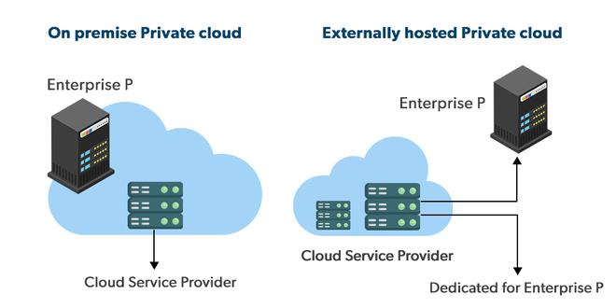
Cloud Deployment Models
Private Cloud:
Private cloud as “internal data center of a business or other organization, not made available to the general public.”

Slide 32
Cloud Deployment Models
Private Cloud:
Private clouds are dedicated infrastructures operated for a single organization, either on-premises or hosted by a third-party provider.
They offer enhanced security, control, and customization options compared to public clouds, suitable for organizations with specific compliance and data sovereignty requirements.

Slide 33
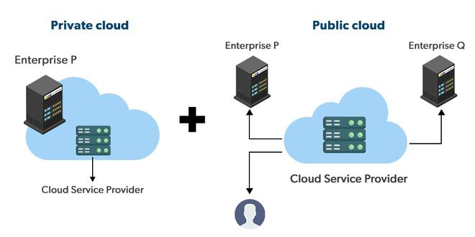
Cloud Deployment Models
Hybrid Cloud:
A hybrid cloud takes shape when a private cloud is supplemented with computing capacity from public clouds.
The approach of temporarily renting capacity to handle spikes in load is known as “cloud-bursting”.

Slide 34
Cloud Deployment Models
Hybrid Cloud:
Hybrid clouds combine public and private cloud environments, allowing data and applications to be shared between them.
Organizations benefit from flexibility, scalability, and the ability to choose the right environment for each workload based on performance, security, and regulatory requirements.

Slide 35
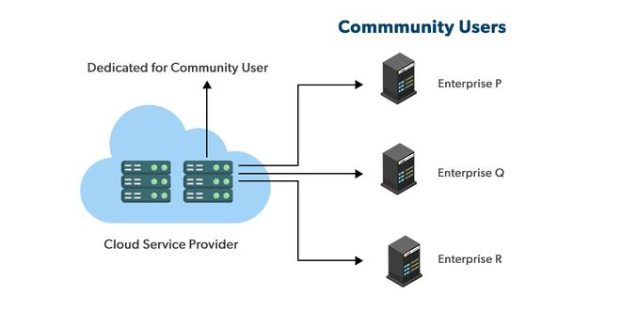
Cloud Deployment Models
Community Cloud:
A community cloud is “shared by several organizations and supports a specific community that has shared concerns (e.g., mission, security requirements, policy, and compliance considerations).”

Slide 36
Cloud Deployment Models
Community Cloud:
Community clouds serve specific groups of organizations with shared concerns (e.g., industry-specific regulations or compliance requirements).
They offer collaborative benefits such as cost-sharing, resource pooling, and standardized services tailored to community needs.

Slide 37
Cloud Deployment Models
Factors | Public Cloud | Private Cloud | Community Cloud | Hybrid Cloud
Initial Setup | Easy | Complex, requires a professional team to setup | Complex, requires a professional team to setup | Complex, requires a professional team to setup
Scalability and Flexibility | High | High | Fixed | High
Cost-Comparison | Cost-Effective | Costly | Distributed cost among members | Between public and private cloud
Reliability | Low | Low | High | High
Data Security | Low | High | High | High
Data Privacy | Low | High | High | High

